Slide 1
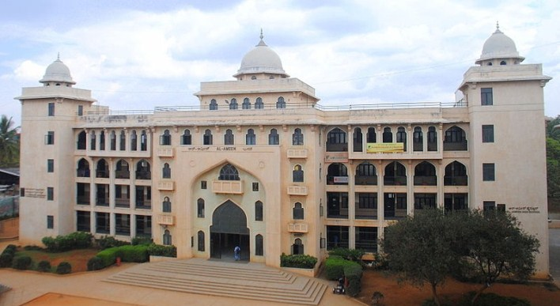
LIBRARY AT AL-AMEEN COLLEGE OF LAW

Slide 2
Vision
To empower, strengthen and enhance the teaching, learning and research in AACL.
Mission
We strive to promote intellectual growth and creativity by developing collections, facilitating access to information resources, to serve the educational needs of the students and faculty of AACL.

Slide 3
OVERVIEW OF LIBRARY ORIENTATION
LIBRARY STAFF
LIBRARY TIMINGS
ABOUT LIBRARY
LOCATION GUIDES
HOW TO GET MEMBERSHIP
LIBRARY SERVICES
LIBRARY RULES
TOTAL COLLECTION IN LIBRARY
DATAILS OF JOURNALS
LIBRARY OPAC
LIBRARY ADVISORY COMITEE

Slide 4
Library Staff
Librarian
Ms. Tabassum Ara. A , M.L.I.Sc.
Library Attender
Mr. Fakurdeen
Attender
Mrs. Ayesha

Slide 5
Library Timings
Library Working Hours
Monday to Friday 9:30 AM to 5:00 PM
Saturday 9:30 AM to 2:00 PM
Circulation Timings
Monday to Friday 09:30 AM to 1:30 PM
02: 00 PM to 4: 00 PM
Saturday : 9:30 AM to 1:30 PM

Slide 6
About Library
A Library is a collection of materials, books that are easily accessible . A library provides physical (hard copies documents) or digital access (soft copies) materials. A library’s collection can include printed materials and other physical resources in many formats such as DVD, CD and Cassette as well as access to information.
The Library was initially setup in 1991 in Al- Ameen College of Law.
The Library is spread over one floor with the total covered area of 1600 sq. mtr. Reading room is well ventilated with the capacity of 60 seats.
The Library has rich collection of documents comprising of books, practical records, journals, compact disc, Periodicals(newspaper and magazines.)
library is fully computerized using the Libsoft software package that also provides web-based access to the online catalogue of Library.

Slide 7
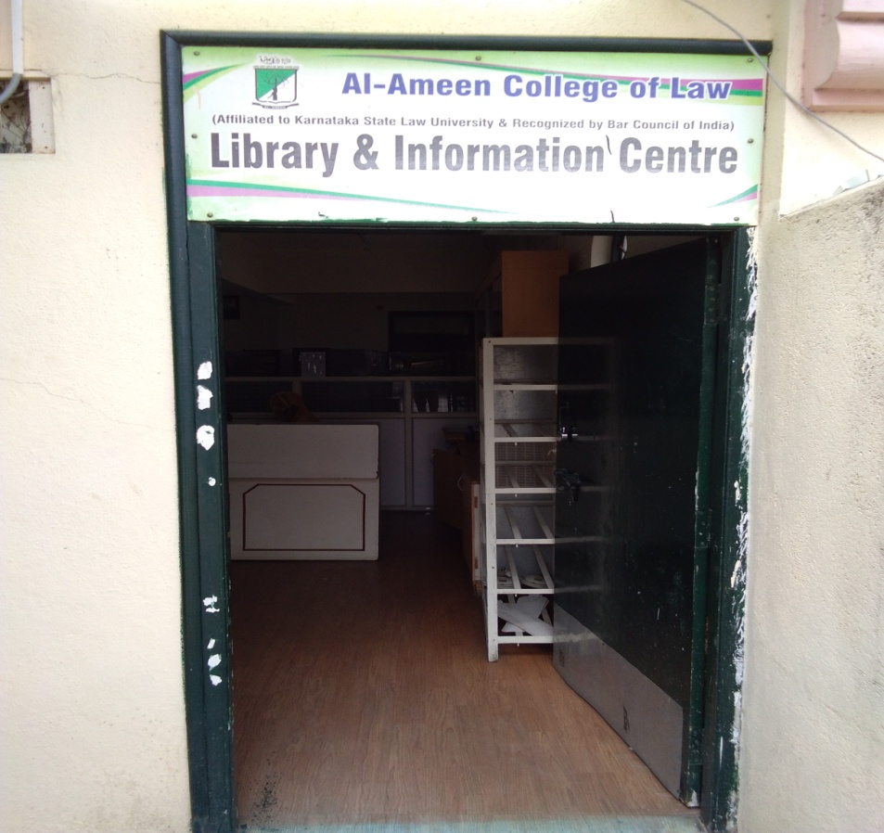
Location Guides
To left
Display rack for new arrival books
Computer Lab
Stacks Area of Journals
OPAC Station ( online public access catalogue.)
To Right
Circulation section
Book Bank Section
Back Volume of Journals
Kannada books
Reference Section
Reading Hall

Slide 8
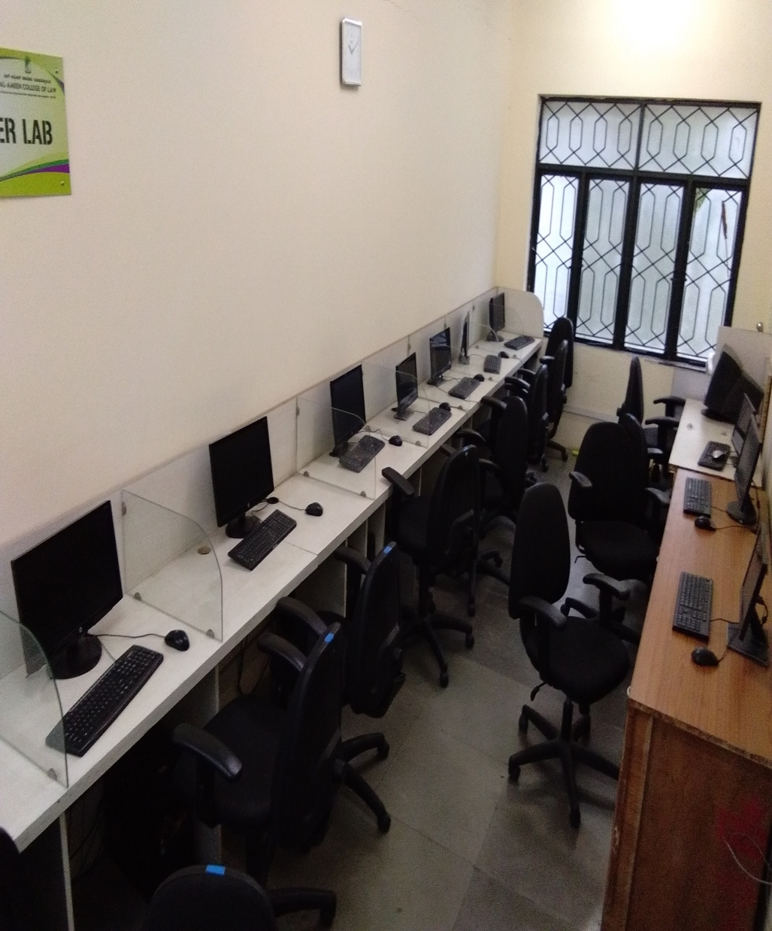
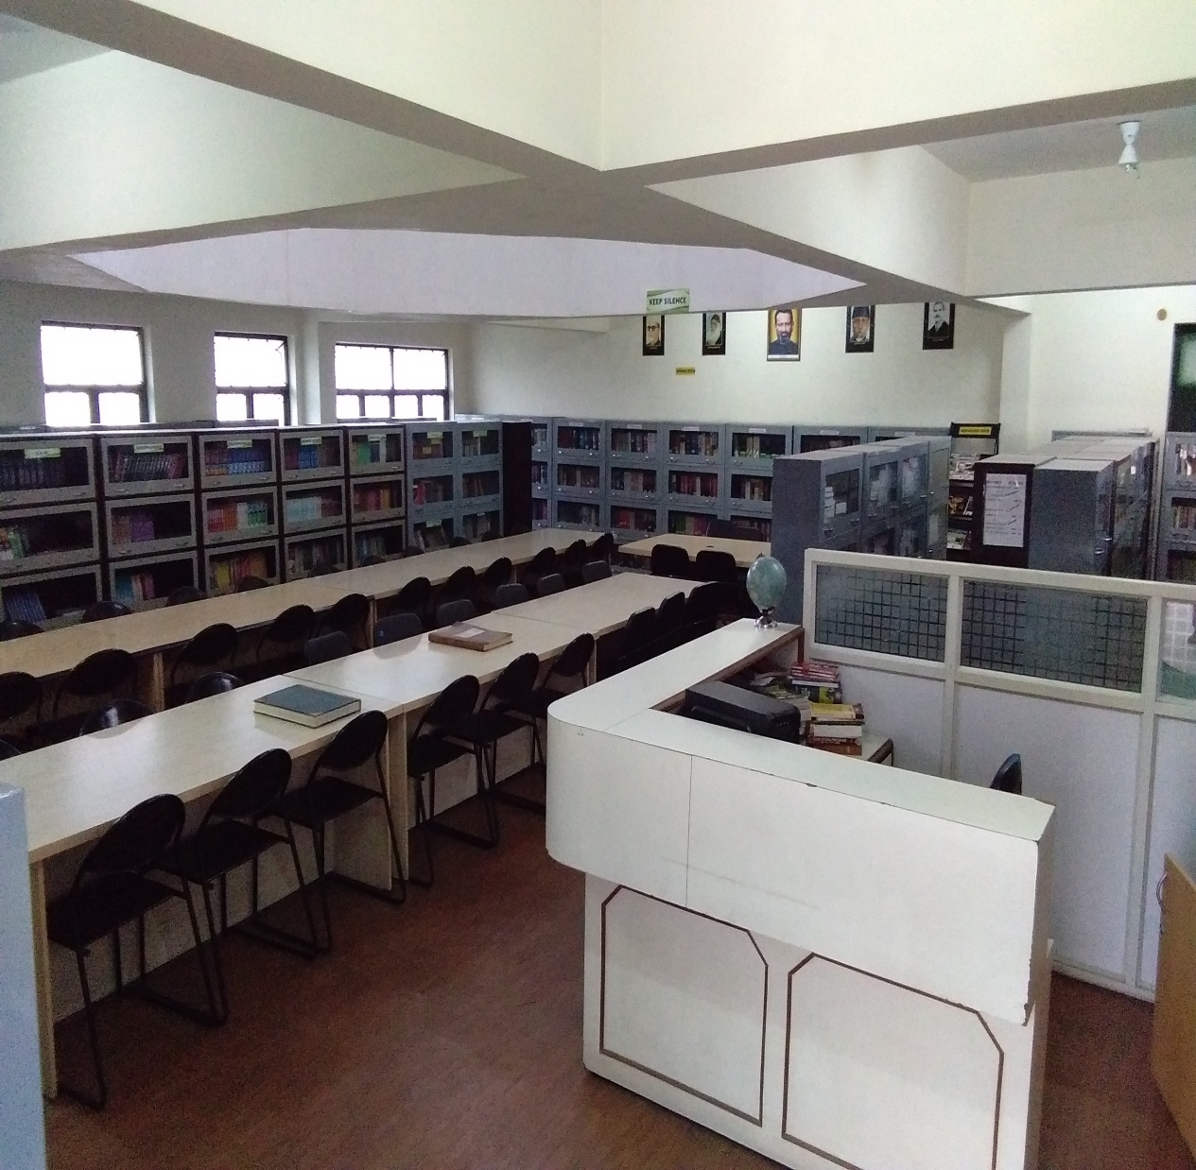

Slide 9
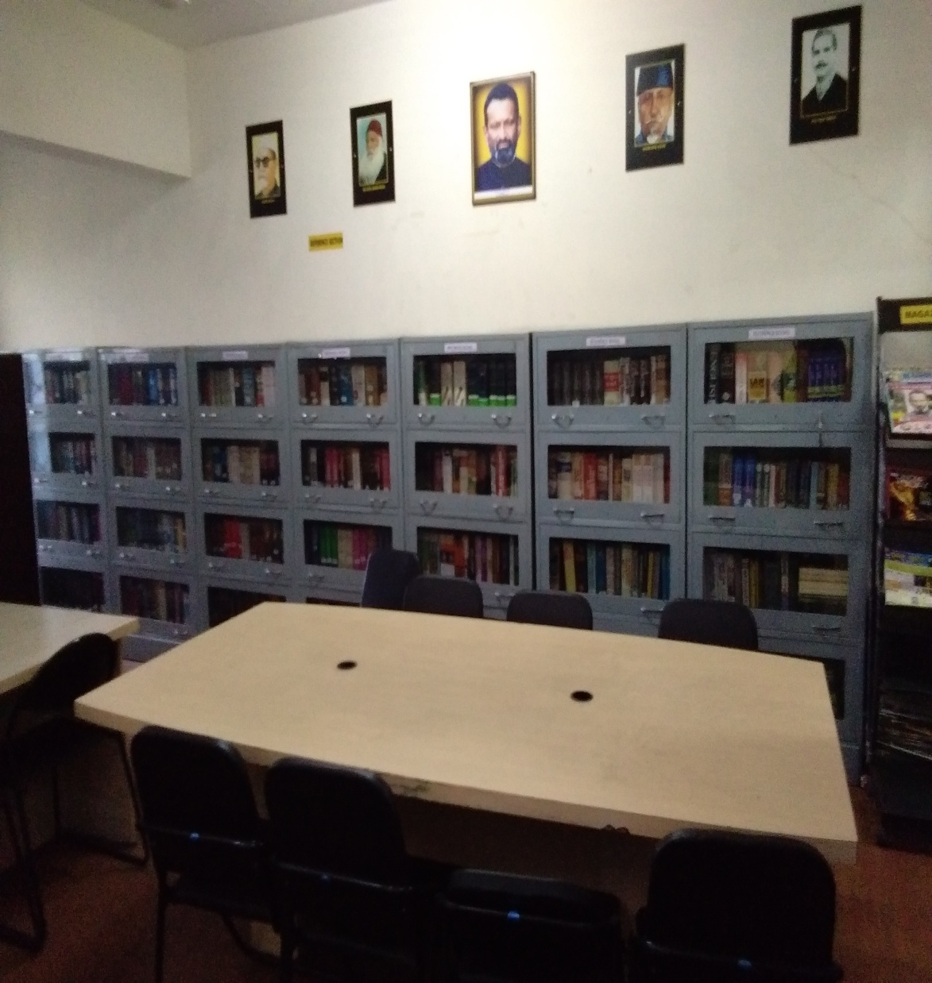

Slide 10
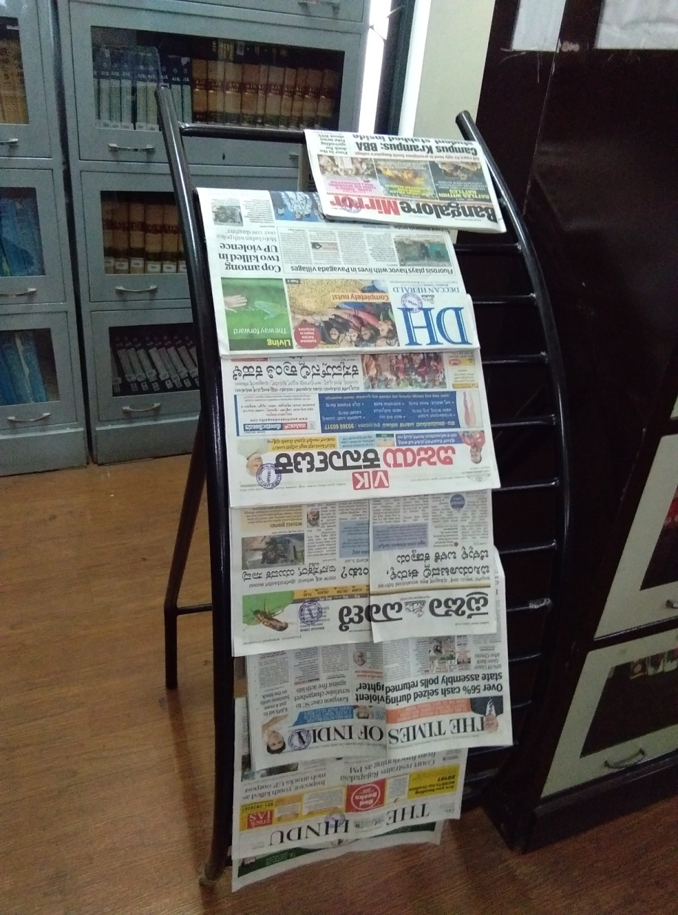
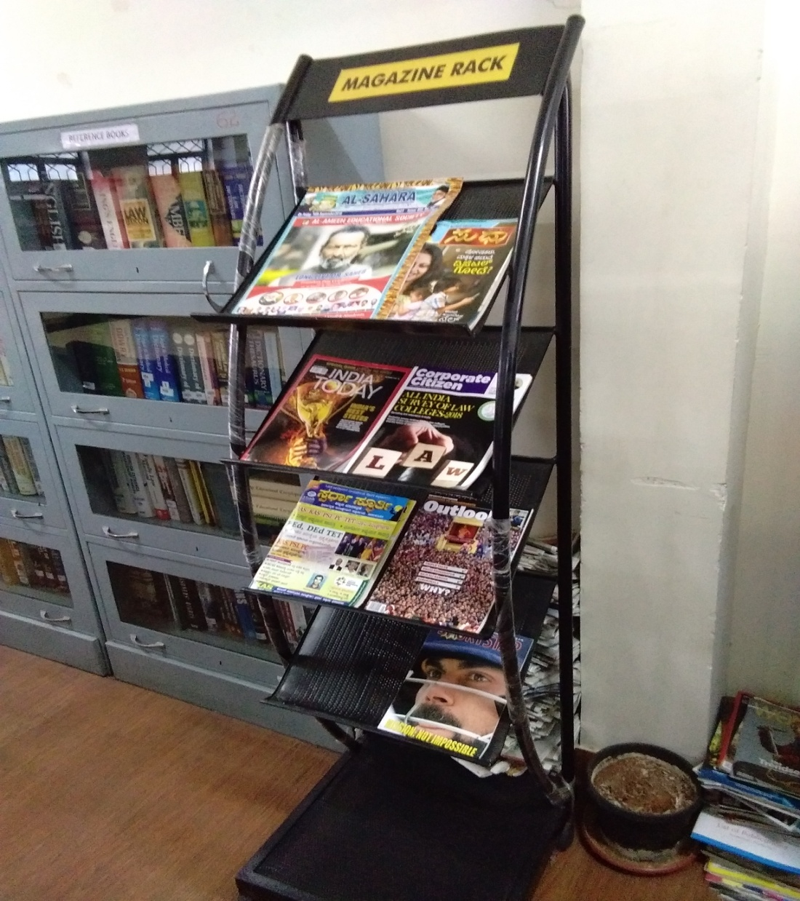

Slide 11
HOW TO GET MEMBERSHIP
Get the library membership Card and library membership form .
Fill the Library Membership Card and Library Membership form in Capital Letters only and affix one unattested Stamp Size Photograph on I .D Card and Library membership form along with two extra stamp size photo.
Get the membership card signed from Librarian.

Slide 12
Library Services
DELNET
INTERNET
EXTRA BOOKS TO POSITION HOLDERS
REPROGRAPHICS
OPAC (Online Public Access Catalogue)
CURRENT AWARENESS SERVICES (CAS)
REFERENCE SERVICES

Slide 13
BOOK BORROWING PROCEDURE
LIBRARY HAS OPEN ACESS.
STUDENT SHOULD GET MEMBERSHIP CARD.
STUDENT SHOULD GET THEIR REQUIRED BOOKS FROM THE LIBRARY.
CHECK THE DUE DATE STAMP ON LAST PAGE OF BOOK.
BOOKS ARE ISSUED TO BE TAKEN AWAY FROM THE LIBRARY FOR A PERIOD OF 15 DAYS.

Slide 14
Library Rules (Generals)
A person desirous to using the library shall enter his/her Name, Class, Roll No. & time of entry legibly and put a signature in the register kept at the entrance for the purpose.
Identity Card (ID) is compulsory for getting access to the library.
Silence to be maintained in the library.
No discussion permitted inside the library.
Membership should be done to become a library member prior to using the library resources. Contd.

Slide 15
Library Rules (Generals)
No personal belongings allowed inside the library.
Textbooks, printed materials and issued books are not allowed to be taken inside the library.
Documents taken out of the shelves must be left on the table. Replacing the documents on shelves by users is not encouraged as the documents may get misplaced.
Using Mobile phones and audio instruments with or without speaker or headphone is strictly prohibited in the library premises.
Contd.

Slide 16
Library Rules (Loan Privilege)
The books shall be issued to students for 15 days after which the same must be returned.
If the books are not returned on the due date, an overdue charge @ Rs 5per book per day will be charged for the period, the books are kept beyond the due date.
The librarian may recall any book from any member at any time
and the member shall return the same immediately.
Contd.

Slide 17
Library Rules (Loan Privilege)
Books will be reissued for not more than two times. After that the borrower must return the book(s).
Reference books, journals / periodicals, magazines/newspapers and other documents declared “For Reference” by the Librarian will not be issued.
A Book Bank facility for SC/ST students available in the library.
Students produce their caste certificate to avail this facility.

Slide 19
Library Rules (Generals)
Show the books and other materials which are being taken out of the library to the staff at the entrance counter.
Library borrower cards are not transferable. The borrower is
responsible for the books borrowed on his/her card.
Refreshment of any kind shall not be taken anywhere in the library premises.
Suggestions on all aspects of library services are welcome

Slide 20
Total Collection of books in the Library
Collection | Total
Subject Books & Reference Books | 10,000
Journals And Periodicals | 2000
E-Journals | 2000
Magazines | 08
News papers | 07

Slide 21
Details of Journals
Sl. No | Journal
1 | Supreme Court Cases
2 | Labour & Industrial cases
3 | Taxation law reports
4 | Supreme Court reports
5 | Labour law journal
6 | Criminal law journal
7 | Civil & Military law journals
8 | All India service law journal
9 | Annual survey of Indian law
10 | Indian journal of international law
11 | Mysore law journal manual
12 | Al-Ameen Law Review

Slide 22
Library OPAC

Slide 23
OPAC – ONLINE PUBLIC ACCESS CATAOGUE
It is a Database used for searching books.

Slide 24
Library Advisory Committee
1. Dr. Waseem Khan M.I. (Patron)
2. Mrs. Yasmeen Tabassum (Member)
3. Ms. Tabassum Ara. A (Member)
4. Mrs. Jayalakshmi V (Member)
5.Mr.Mubarak Khan(Member)

Slide 25
THANK YOU
YOUR SUGGESTIONS ARE WELCOME TO IMPROVE THE SERVICES OF OUR LIBRARY.

